Slide 1
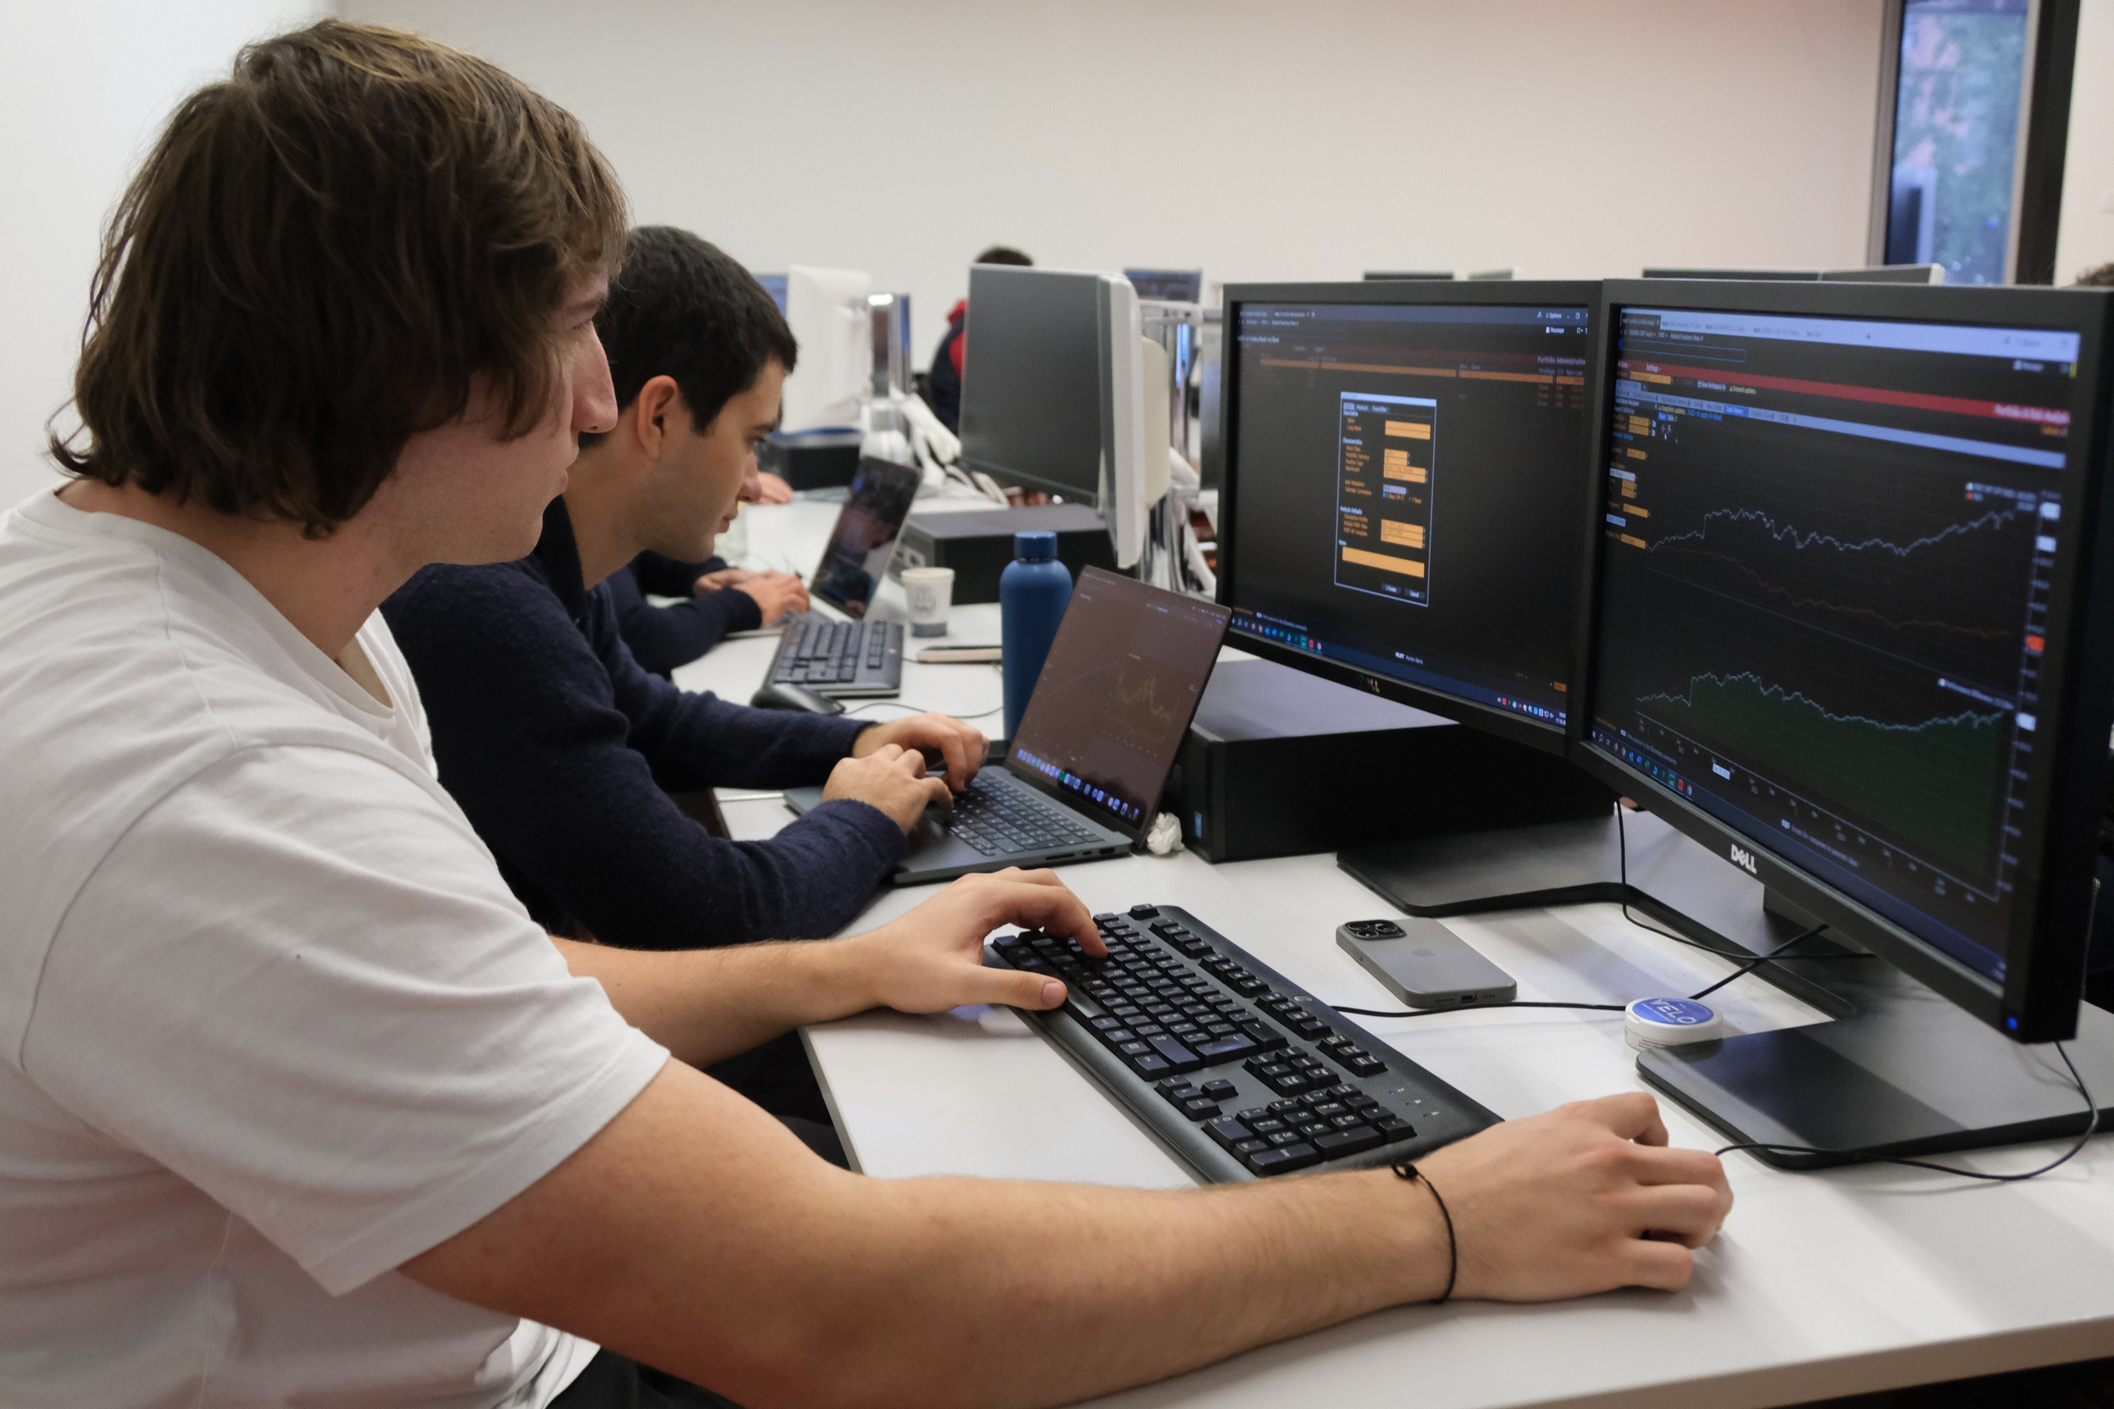
AURORA CAPITAL MANAGEMENT
AMC Round 3 - Group 7
HTTPS://AURORACAPM.CH

Slide 2
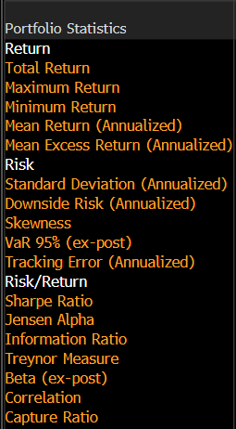
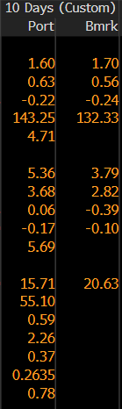
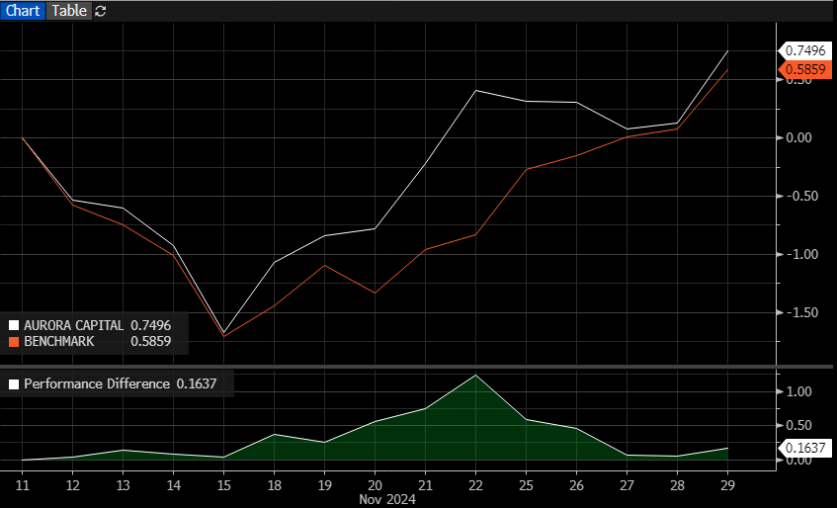
AURORA CAPITAL MANAGEMENT
SECOND ROUND ANALYSIS
HTTPS://AURORACAPM.CH
Performance Overview (Nov 11 - Nov 27):
Aurora Capital outperformed its benchmark BMADM64 despite similar drawdowns (-1.5% on November 15).
Recovery peaked with a 1.5% performance difference on November 22.
Closed with a cumulative return of 0.75% vs. the benchmark’s 0.58%.
Effective recovery highlighted but noted challenges in maintaining momentum.
Statistical Highlights:
Return: Higher annualized mean return (Aurora: 143.25% vs Benchmark: 132.33%).
Risk: Slightly higher risk (Standard Deviation: 5.36% Aurora vs 3.79% Benchmark).
Risk-Adjusted Return: Strong Jensen Alpha (55.10) despite a lower Sharpe Ratio.

Slide 3
AURORA CAPITAL MANAGEMENT
EQUITY ALLOCATION RESULTS
HTTPS://AURORACAPM.CH
Top Performers
Smiths Group (+13.9%): Driven by AI integration and buy recommendations.
MPLX: Benefited from robust energy demand, securing strong operational growth.
Nan Pao Resins: Growth supported by sustainable product expansion.
......................................................
Underperformers:
Target Corp: Missed Q3 earnings; stock declined.
Sumitomo Bakelite: Failed to meet R&D targets.
Jumpcan Pharmaceutical: Patent delays led to a 9% decline.

Slide 4
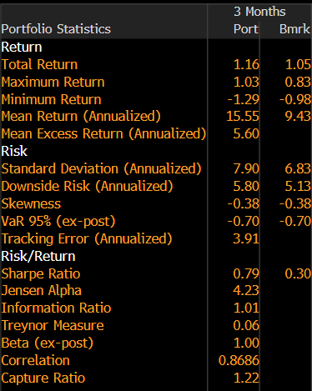
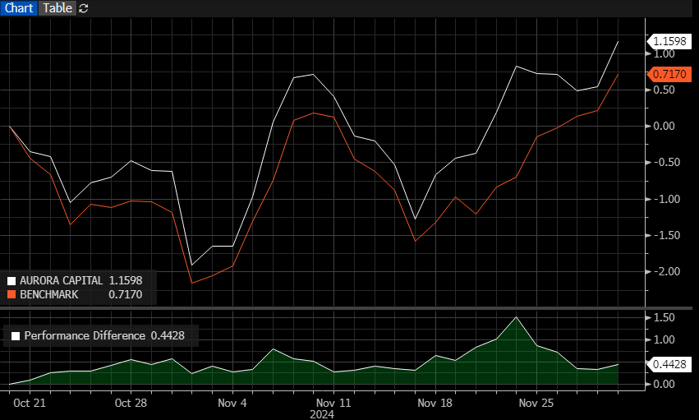
AURORA CAPITAL MANAGEMENT
OVERALL ANALYSIS
HTTPS://AURORACAPM.CH
Consistent Outperformance: Aurora Capital significantly outperformed its benchmark, FGFD, across multiple metrics.
Robust Risk Management: The portfolio demonstrated effective risk management, with controlled downside risk and a strong VaR.
Successful Active Management: Active strategies contributed to the portfolio's superior performance.
Resilience in Volatile Markets: The portfolio displayed resilience in navigating market fluctuations.
Portfolio return: 1.16%, outperforming benchmark (1.05%).
Risk metrics: Annualized volatility of 7.9% balanced by a superior Sharpe ratio of 0.79 vs. benchmark’s 0.30.

Slide 5


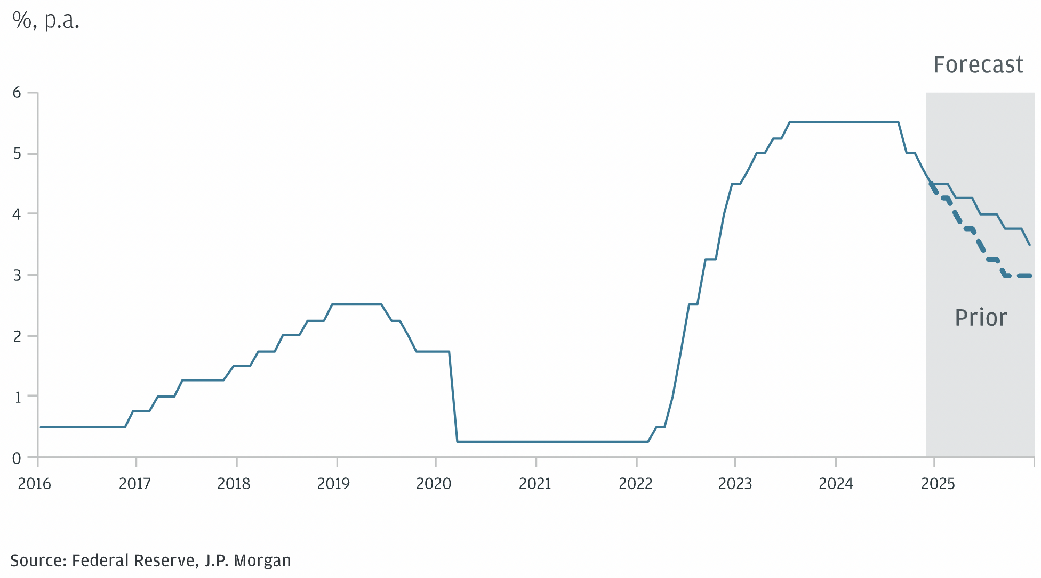
AURORA CAPITAL MANAGEMENT
MACRO ANALYSIS
HTTPS://AURORACAPM.CH
Global Growth: Resilient U.S. economy vs. Eurozone (0.4% Q3 growth) and deflationary China.
Monetary Policy: ECB rate cuts expected; Fed balances inflation risks.
Equities: Favourable for U.S. equities, cautious on Japan; consumer discretionary upgraded to neutral.
Geopolitics: Ongoing risks from Ukraine and Middle East conflicts.

Slide 6
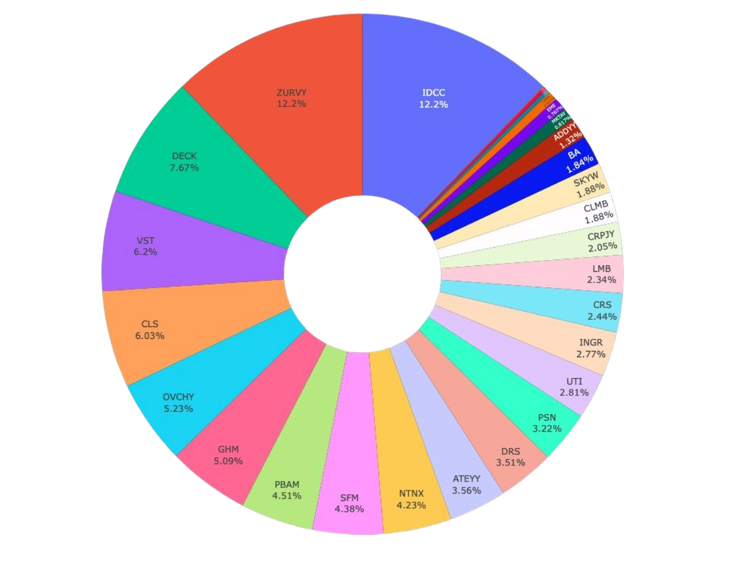
AURORA CAPITAL MANAGEMENT
NEW EQUITY ALLOCATION
HTTPS://AURORACAPM.CH
1. Valuation Filters
Focused on key metrics such as P/E and P/S ratios.
Objective: Identify equities with attractive relative valuations.
2. Quality Metrics
Emphasized projected earnings growth rates and EPS estimate revisions.
Goal: Select companies with strong financial health and growth potential.
3. Momentum Factors
Analyzed short-term (1-week) and medium-term (4-week) price movements.
Targeted securities with strong upward trends to capture momentum.
4. Multi-Dimensional Filtering Approach
Combines valuation, quality, and momentum factors.
Results in a concentrated portfolio designed to:
Leverage prevailing market conditions.
Deliver superior risk-adjusted returns.

Slide 7
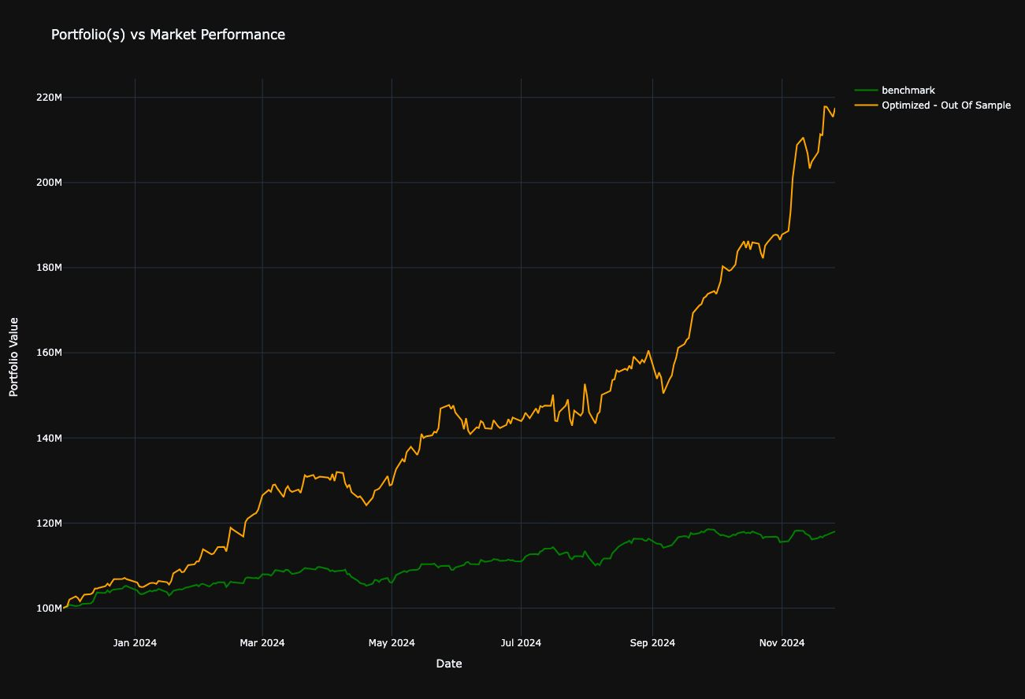
AURORA CAPITAL MANAGEMENT
BACKTEST & OPTIMIZATION OF EQUITY ALLOCATION
HTTPS://AURORACAPM.CH
1. Information Ratio Optimization
• Conducted using our proprietary Python package.
• Focused on fine-tuning portfolio composition against the 2023 benchmark to maximize risk-adjusted returns.
2. Out-of-Sample Analysis
• Tested the optimized portfolio in 2024 to evaluate performance in a different market environment.
• Ensures the strategy is both theoretically sound and empirically validated.
3. Performance Results
• Equally Weighted Portfolio (2023 in-sample): Information Ratio of 2.7.
• Optimized Portfolio (2023 in-sample): Information Ratio of 4.77.
• Optimized Portfolio (2024 out-of-sample): Information Ratio of 4.11.

Slide 8

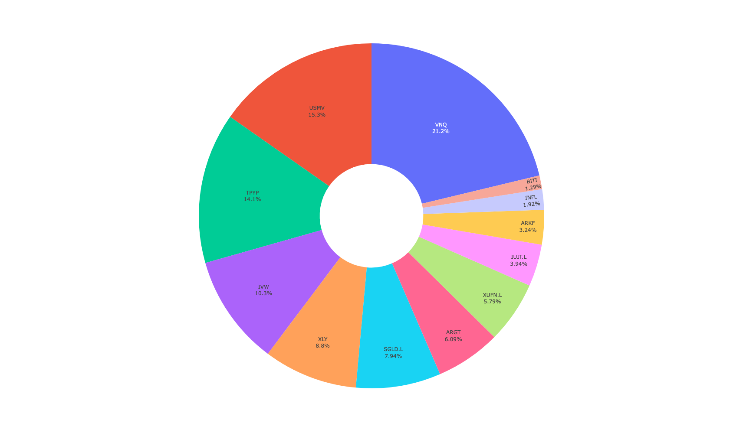
AURORA CAPITAL MANAGEMENT
ETF PORTFOLIO
Top Holdings:
1. Vanguard Real Estate ETF (VNQ): Tracks the performance of the MSCI US IMI 25/50 Real Estate Index, focused on real estate investments.
2. iShares MSCI USA Min Vol Factor ETF (USMV): Composed of U.S. equities with lower volatility characteristics compared to the broader U.S. equity market.
3. Tortoise North American Pipeline Fund (TPYP)The Tortoise North
American Pipeline Fund uses a passive management approach and
seeks to track the total return performance of the Tortoise North American Pipeline Index
Key Portfolio Changes:
• Gold Adjustment: Successfully reduced the position in SGLD to 7.94% (from 14.952%) in the second round to comply with guideline limitations.
• ARGT Stability: Maintained a consistent allocation to ARGT at 6.09%.
HTTPS://AURORACAPM.CH

Slide 9
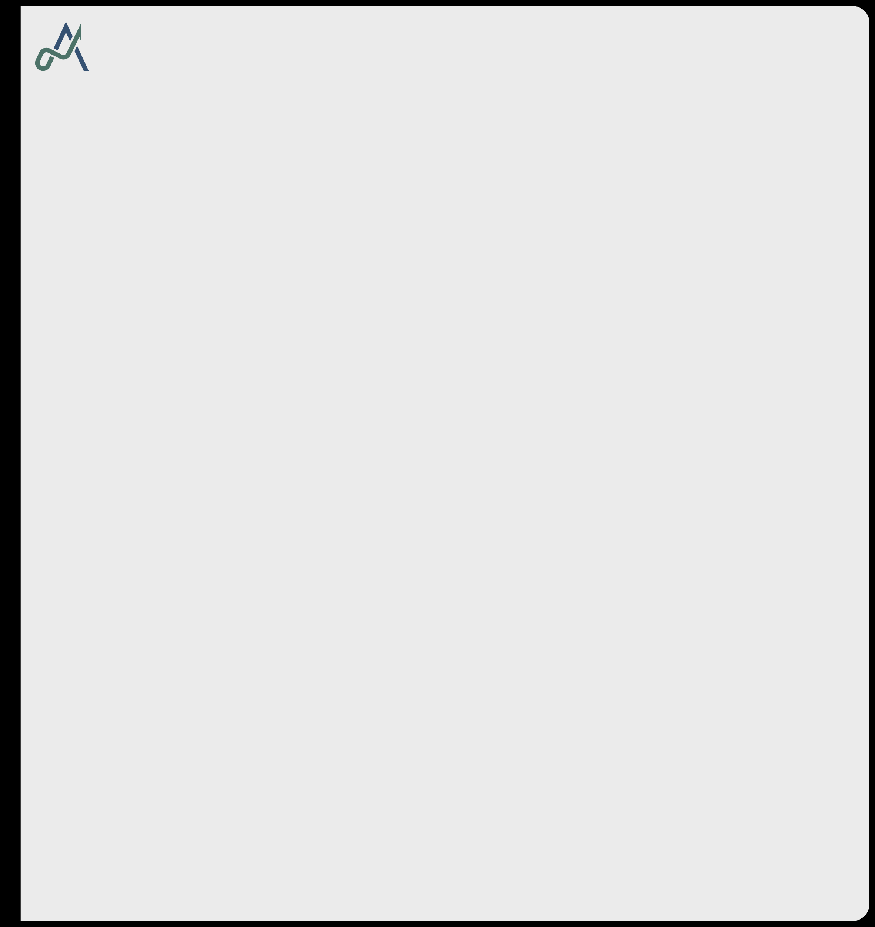
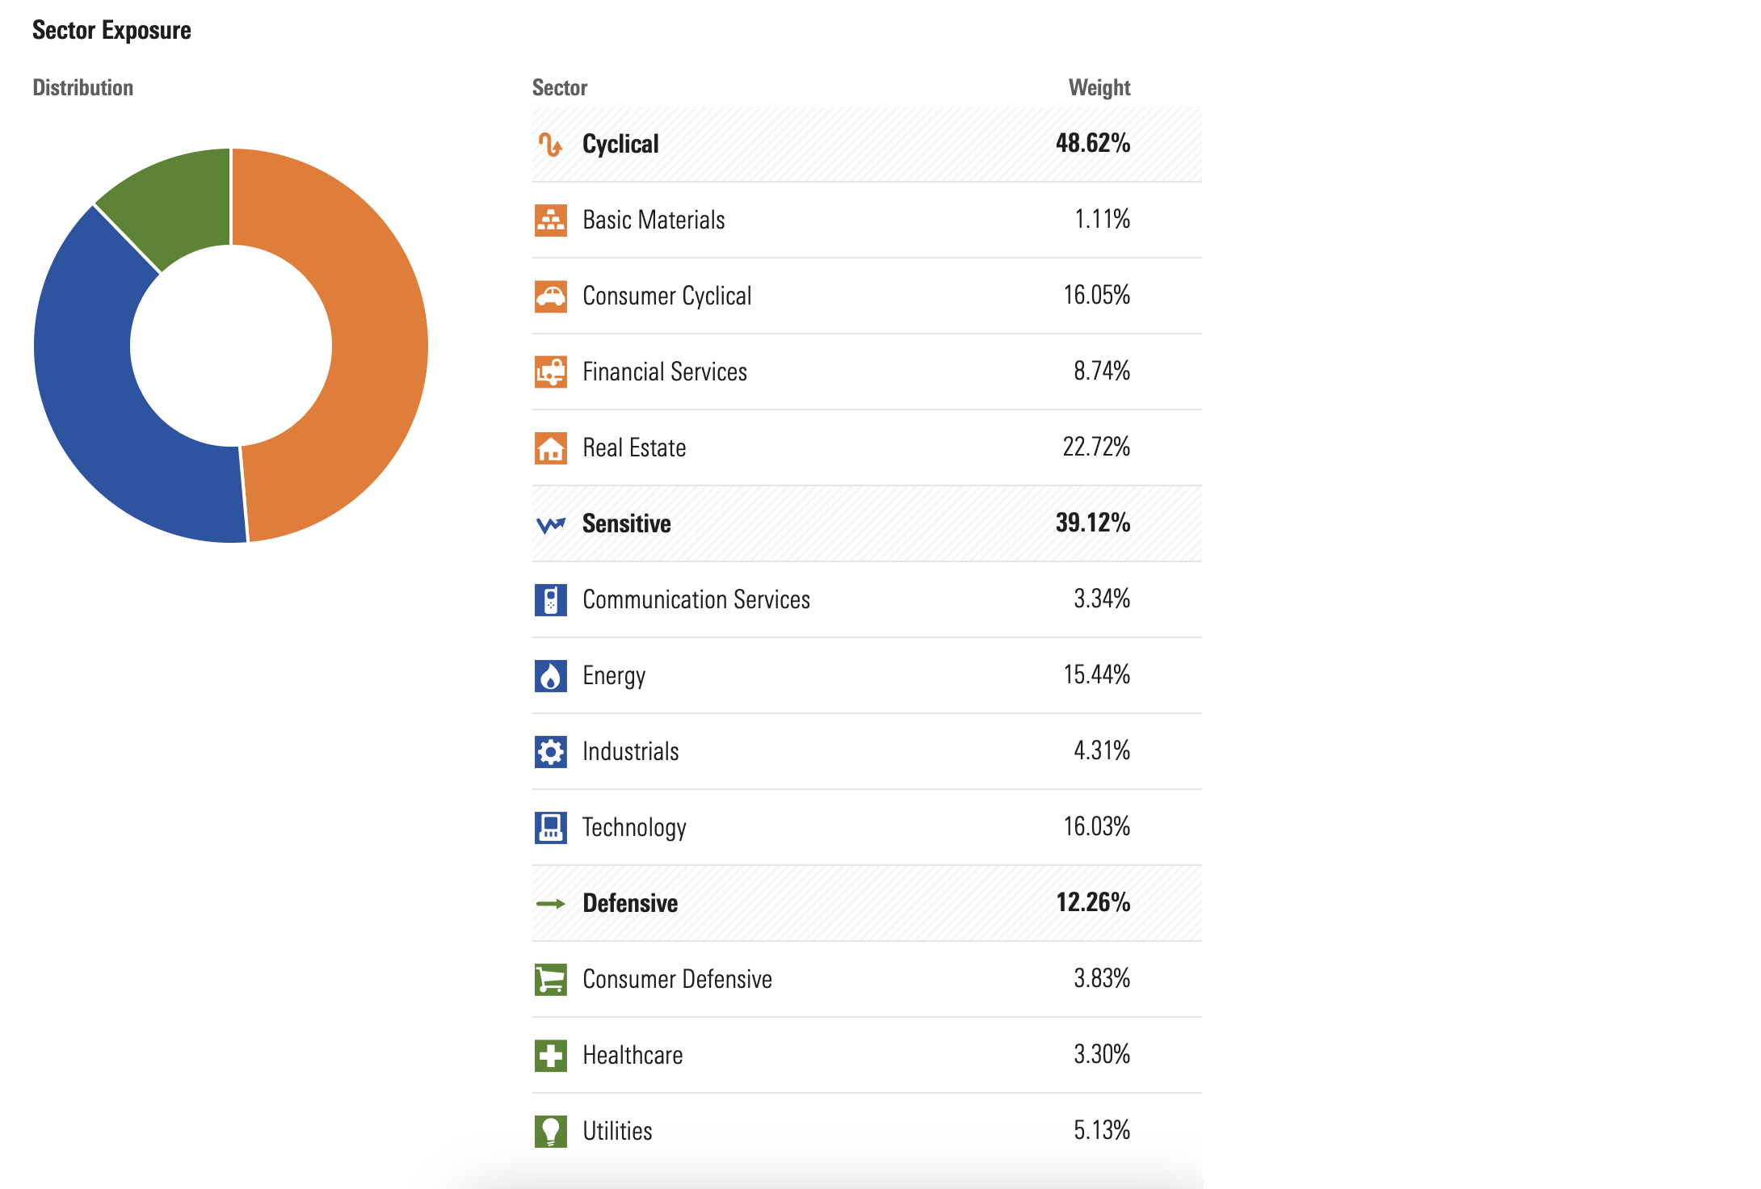
AURORA CAPITAL MANAGEMENT
SECTORIAL ALLOCATION
This sectoral allocation reveals a strong emphasis on cyclical sectors, which comprise 48.62% of the portfolio. Real Estate stands out as the largest allocation within this category at 22.72%, followed by Consumer Cyclical at 16.05%.
Sensitive sectors make up 39.12% of the portfolio, with Energy being the most significant contributor at 15.44%, followed by Technology at 16.03%.
Defensive sectors constitute 12.26% of the portfolio, with a relatively even distribution across Utilities (5.13%), Consumer Defensive (3.83%), and Healthcare (3.30%).
Overall, the allocation reflects a preference for economically sensitive and growth-driven sectors, with a relatively modest focus on defensive areas.
HTTPS://AURORACAPM.CH

Slide 10
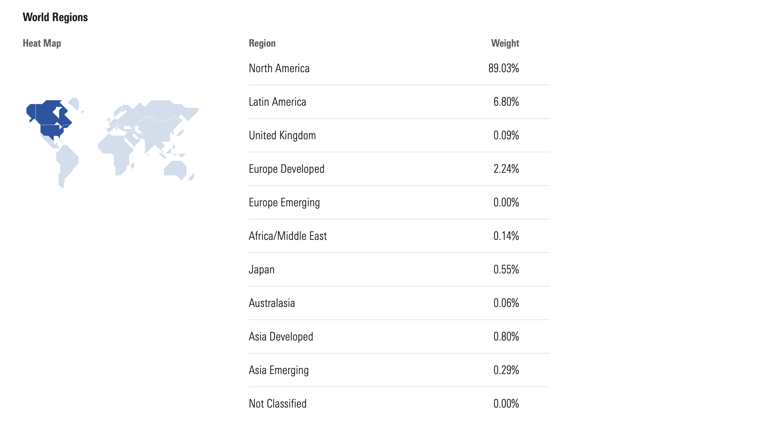
AURORA CAPITAL MANAGEMENT
GEOGRAPHICAL CHART
This regional allocation demonstrates a strong concentration in North America, which comprises 89.03% of the portfolio, indicating a clear reliance on this market.
Latin America accounts for 6.80%, representing the next most significant exposure. Other regions, such as Europe Developed (2.24%) and Japan (0.55%), have minimal allocations, while regions like Europe Emerging and Africa/Middle East are nearly absent.
Asia Developed and Asia Emerging together contribute just over 1%, reflecting limited diversification in these areas.
Overall, this allocation is heavily skewed toward North America, with minimal exposure to other global regions, suggesting a focus on markets with established economic stability.
HTTPS://AURORACAPM.CH

Slide 11
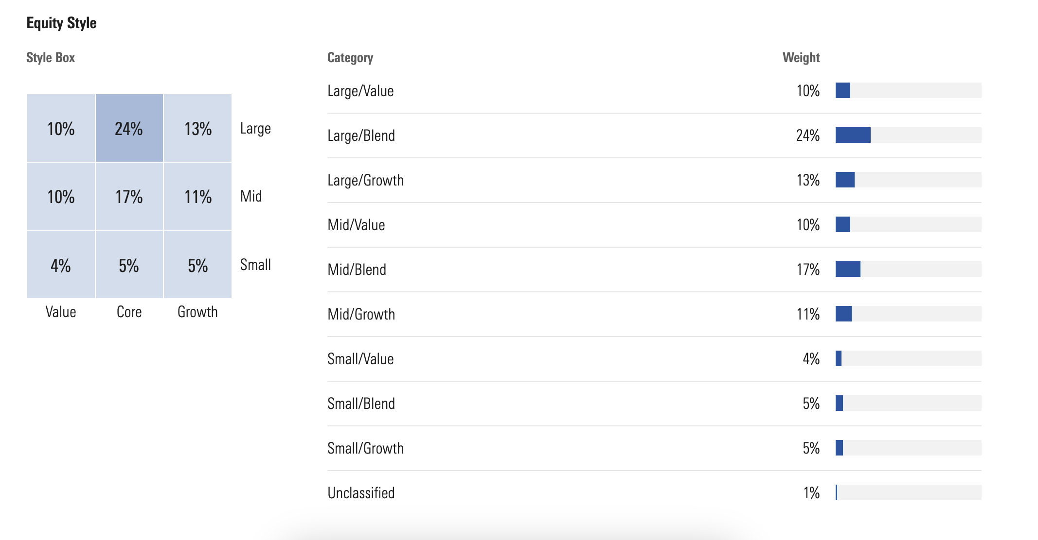
AURORA CAPITAL MANAGEMENT
SECTORIAL ALLOCATION
This equity style allocation emphasizes a strong preference for large-cap stocks, which constitute 47% of the portfolio, with a significant allocation to the large/blend category at 24%.
This suggests a balanced approach among value, core, and growth characteristics within large-cap equities, with moderate tilts toward large/value (10%) and large/growth (13%).
Mid-cap stocks make up 38% of the portfolio, with a balanced distribution across value, blend, and growth categories, reflecting diversification within this segment.
Small-cap stocks represent only 14% of the portfolio, with similar weights across value, blend, and growth, indicating a more limited focus on smaller companies.
Overall, the allocation reflects a strategy favoring large and mid-cap stocks, particularly those with a blend of value and growth characteristics, while maintaining limited exposure to small-cap equities. This approach likely aims to balance stability with growth potential.
HTTPS://AURORACAPM.CH

Slide 12

LET’S
CONNECT
Thank You for Attention
+41 78 209 41 52 info@auroracapm.ch
HTTPS://AURORACAPM.CH

